Slide 1

 | Shri Shivaji Vidya Prasarak Sanstha’s Bapusaheb Shivajirao Deore Polytechnic, Dhule Academic Year : 2023 – 2024 Department of Computer Engineering
A seminar on Capstone Project Proposal (CPP-22058)
Topic |  | Student Academic Progress Management
Presented by |  | 1.Badgujar Mohit Hemant
 |  | 2.Bhat Atharva Yogesh
 |  | 3.Deore Samarthya Ravindra
 |  | 4.Makhija Dhruv Harish
Guided by |  | Mr. C. P. Bhamare
Semester |  | 5 I | Date : 14 / 11 / 2023

Slide 2
Content
1. Abstract
2. Introduction and Background of the Industry
3. Literature Survey
3.1 Study of existing system / Review of Research Papers
3.2 Limitations of existing system / Problems discussed in research papers
3.3 Problem Identification /need of a system
3.4 Problem Definition
4. Specifications
4.1 User Requirements
4.2 System Requirements
5. Proposed Detailed Methodology of solving indentified problem
5.1 Proposed work
5.2 Proposed Design
6. Week wise Action Plan – for Sixth semester
7. References and Bibliography

Slide 3
1. Abstract
The proposed system – “Student Academic Progress Management” will help students in monitoring the progress of teaching.
This system will –
Helps student to see Timetable, Syllabus, Attendance, and Submissions.
Provide a facility to Store Student Information regarding Submissions, Attendance(Lecture/Practical).

Slide 4
2. Introduction
Attendance, Class-test Marks, Submission Report, Timetable, Assignments And Practical Submissions plays an important role to manage student record.
To manage the records manually is difficult, time consuming and causes lack of accuracy and data loss.
To overcome these problems, we aim to computerize all the student record and make it easy for college faculty to manage and keep backup of these data.
Where as for students, they can view there attendance(theory and practical), class-test marks, class wise timetable, submission report, assignments and practical submissions.

Slide 5
3. Literature Survey
3.1 Study of existing system / Review of Research Papers
In our college attendance is taken by calling roll no. and fills up the presenty in the muster table, which is time consuming.
Assignment details are managed by filling up the submission muster which make it hard to gather the details.
The marks of the conducted class test’s are filled up in the muster, which may consume time and also makes hard to access the marks when needed .
Creating the submission report can be a time-consuming and tiring task for students, as they are required to collect faculty signatures for approval.

Slide 6
3. Literature Survey
3.2 Limitations of existing system / Problems discussed in research papers
Lack of real-time attendance tracking, leading to potential inaccuracies and delays in updating attendance records.
Challenges in tracking and managing the submission of assignments , practical, including lack of traceability and may cause error.

Slide 7
3. Literature Survey
3.3 Problem Identification /need of a system
In the current system, the use of paper-based attendance sheets is done to maintain student records, leading to difficulties and issues in management.
Keepings records of student in paper-sheets files with less accuracy resulting in misplaced of files, damaged files or even results in data loss. Such records are hard to retrieve, and are Time consuming. Also when in emergencies.

Slide 8
3. Literature Survey
As manually keeping records of students Attendance, test marks, practical marks which are on papers, musters does not have any backups causes it to have big loss of data in any circumstances
To Overcome the problem of student data management regarding student attendance, Assignment & Practical submissions, class Test marks, Timetable.

Slide 9
3. Literature Survey
3.4 Problem Definition
Proposed system is a web application which will be developed for managing student attendance (theory and practical), test record, submission record(assignment and practical), microproject marks.

Slide 10
4. Specification
4.1 User Requirements
View:
Attendance (Number of Lectures Attended)
Submissions (Assignments and Practical)
Syllabus
Timetable
Class Test Marks (1st and 2nd)

Slide 11
4. Specification
Feedback of teachers teaching and facilities provided to them
Submission Report (No dues)
Notes shared by teachers
Letter to HOD for personal or emergency reasons
Overall Report:
Total percentage of attendance
Marks obtained by student in Class Test 1 and 2
Submissions Report (No dues, Assignment, Practical)
Teachers Remark

Slide 12
4. Specification
4.2 System Requirements:
Operating System: Windows OS
RAM: 2 GB(Min)
Processor: Intel Core i3

Slide 13
5.2 Proposed Design (Student flow)
START
LOGIN
View division wise time table
View Syllabus
View Notice
View Attendance
Select Subject wise batch
View Assessment
View Submission
View Cass test marks
View Practical marks
View Submission Report
END

Slide 14
5.2 Proposed Design (HOD’s Flow)
START
LOGIN
Upload Time Table
Approve submission Report
View Progress of Students
Send Notic
END

Slide 15
5.1 Proposed work

Slide 16
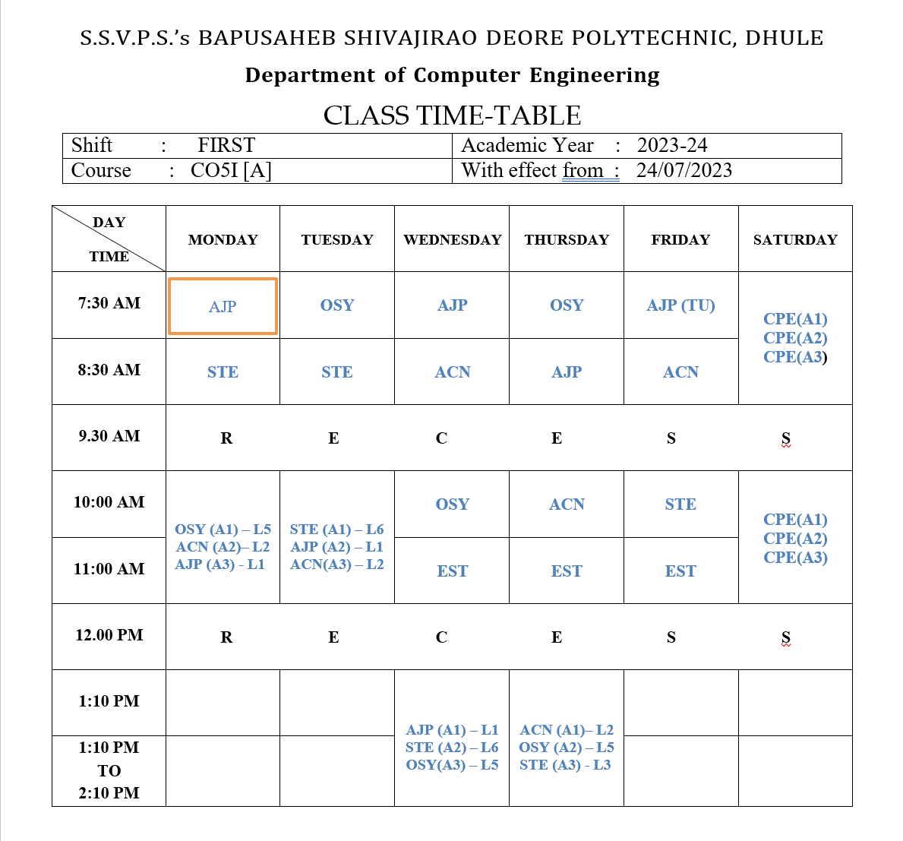

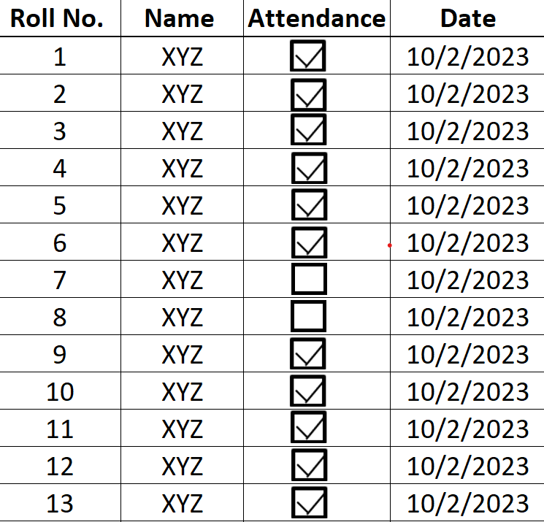
5.1 Proposed work(Attendance)
Clicked

Slide 17
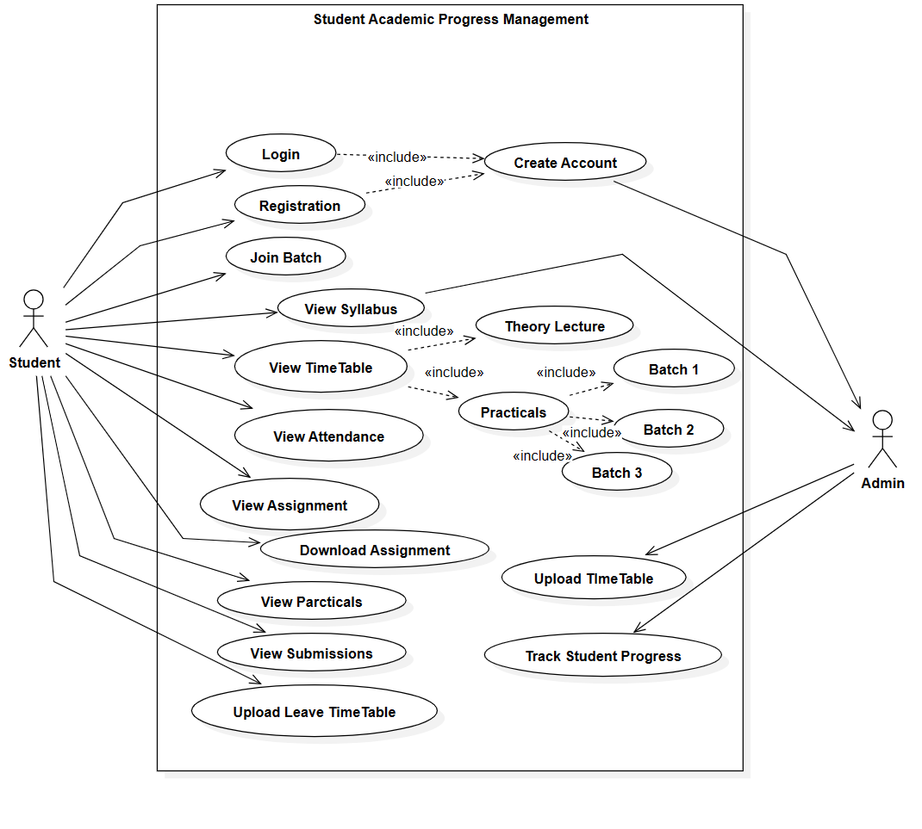
5.2 Proposed Design

Slide 18
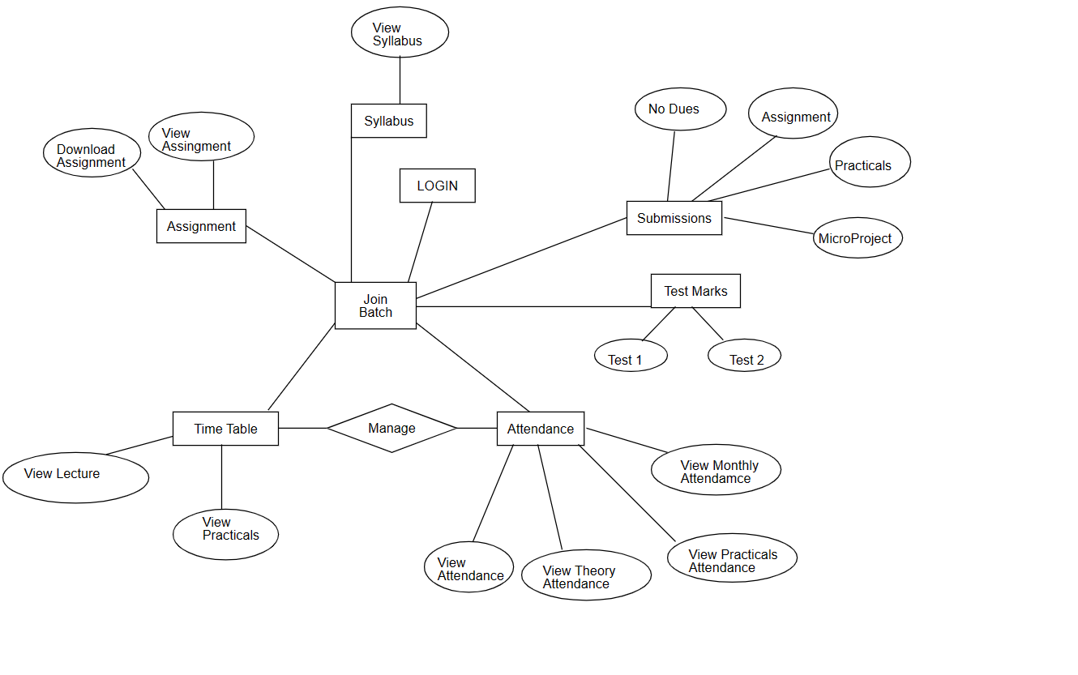
5.2 Proposed Design

Slide 19
6. Week wise Action Plan – for Sixth semester
Sr. No. | List of Activities | Week | Dates
1 | Design User Interface | Week 1 | 01/01/2024 to 06/01/2024
2 | Design database structure, create database | Week 2 | 07/01/2024 to 13/01/2024
3 | Develop GUI and various Interfaces | Week 3 | 14/01/2024 to 20/01/2024
4 | Programming / coding , database connectivity, if required | Week 4 | 21/01/2024 to 27/01/2024
 |  | Week 5 | 28/01/2024 to 03/02/2024
5 | Installation of Project, Dummy Data Entry | Week 6 | 04/02/2024 to 10/02/2024
6 | Testing | Week 7 | 11/02/2024 to 17/02/2024
7 | Modifications (if any required) | Week 8 | 18/02/2024 to 24/02/2024
8 | Project Report Writing | Week 9 | 25/02/2024 to 02/03/2024
9 | Submission of project report | Week 10 | 03/03/2024 to 09/03/2024

Slide 20
7. References and Bibliography
The Academic Portfolio System (APS) Usage Intention of Senior High ...
https://www.mdpi.com/2071-1050/13/15/8394
The Use of Student's Performance - ERIC https://files.eric.ed.gov/fulltext/ED504219.pdf-
GitHub Repository:-
https://docs.github.com/en/get-started/quickstart/create-a-repo

Slide 21
Thank You!!

